Slide 1

Digital Diplomat Solution Type: Prototype
Team Member (Solo): Mayur C
Apriori Model Market Basket Analysis using Azure Data Engineering Tools
Notes:
Korrie

Slide 2
Integrating various data sources and platforms is a significant pain point, requiring seamless data flow from ingestion to processing and analysis.
The Opportunity
The Retail Industry is increasingly driven by data analytics, with companies leveraging transaction data to understand customer behavior and optimize product offerings.
Handling large-scale data efficiently is a common challenge, especially in retail where transaction volumes can be massive, necessitating scalable data engineering solutions.
Integrating various data sources and platforms is a significant pain point, requiring seamless data flow from ingestion to processing and analysis.
There is a growing demand for real-time analytics to enable faster decision-making, which is often constrained by traditional data processing methods.
Advanced analytical models, such as the Apriori algorithm, present opportunities for businesses to uncover hidden patterns in customer purchasing behavior, enabling targeted marketing and personalized shopping experiences.
Notes:
Korrie
updated 7/21

Slide 3
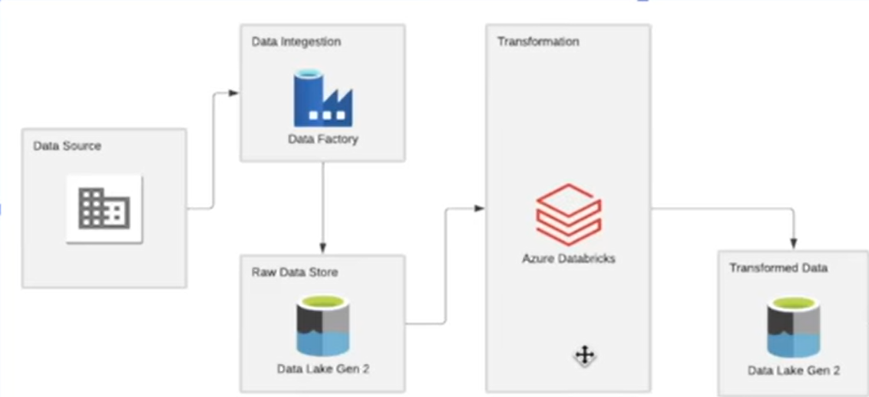
Apriori Model Market Basket Analysis using Azure Data Engineering Tools
Notes:
Korrie
updated 7/21

Slide 4
Solution
Utilized Azure Data Factory to efficiently ingest large volumes of retail transaction data from multiple sources into a centralized data lake.
Stored ingested data in Azure Data Lake, providing a scalable and secure environment for raw data storage, ensuring data availability for downstream processing.
Employed Azure Databricks to transform and clean the raw data, preparing it for advanced analytics by removing inconsistencies and ensuring data quality.
Stored the transformed data in a separate Azure Data Lake, organized for efficient retrieval and analysis, enabling a clear distinction between raw and processed data.
Downloaded the processed data and applied the Apriori algorithm in Google Colab, leveraging its computational capabilities to perform market basket analysis and extract actionable insights.
Notes:
Korrie
updated 7/21

Slide 5
Demo
Let’s take a tour of the solution.
Notes:
Korrie
updated 7/21

Slide 6
Takeaways
Implementing a robust data pipeline using Azure services streamlined the process of data ingestion, transformation, and storage, demonstrating the power of cloud-based data engineering tools.
Azure's scalable infrastructure allowed for efficient handling of large datasets, while Google Colab provided the flexibility to perform advanced analytics in a user-friendly environment.
The integration of Azure services with Google Colab showcased how different platforms can be combined to create a powerful analytics solution.
Notes:
Korrie
updated 7/21

